Slide 1
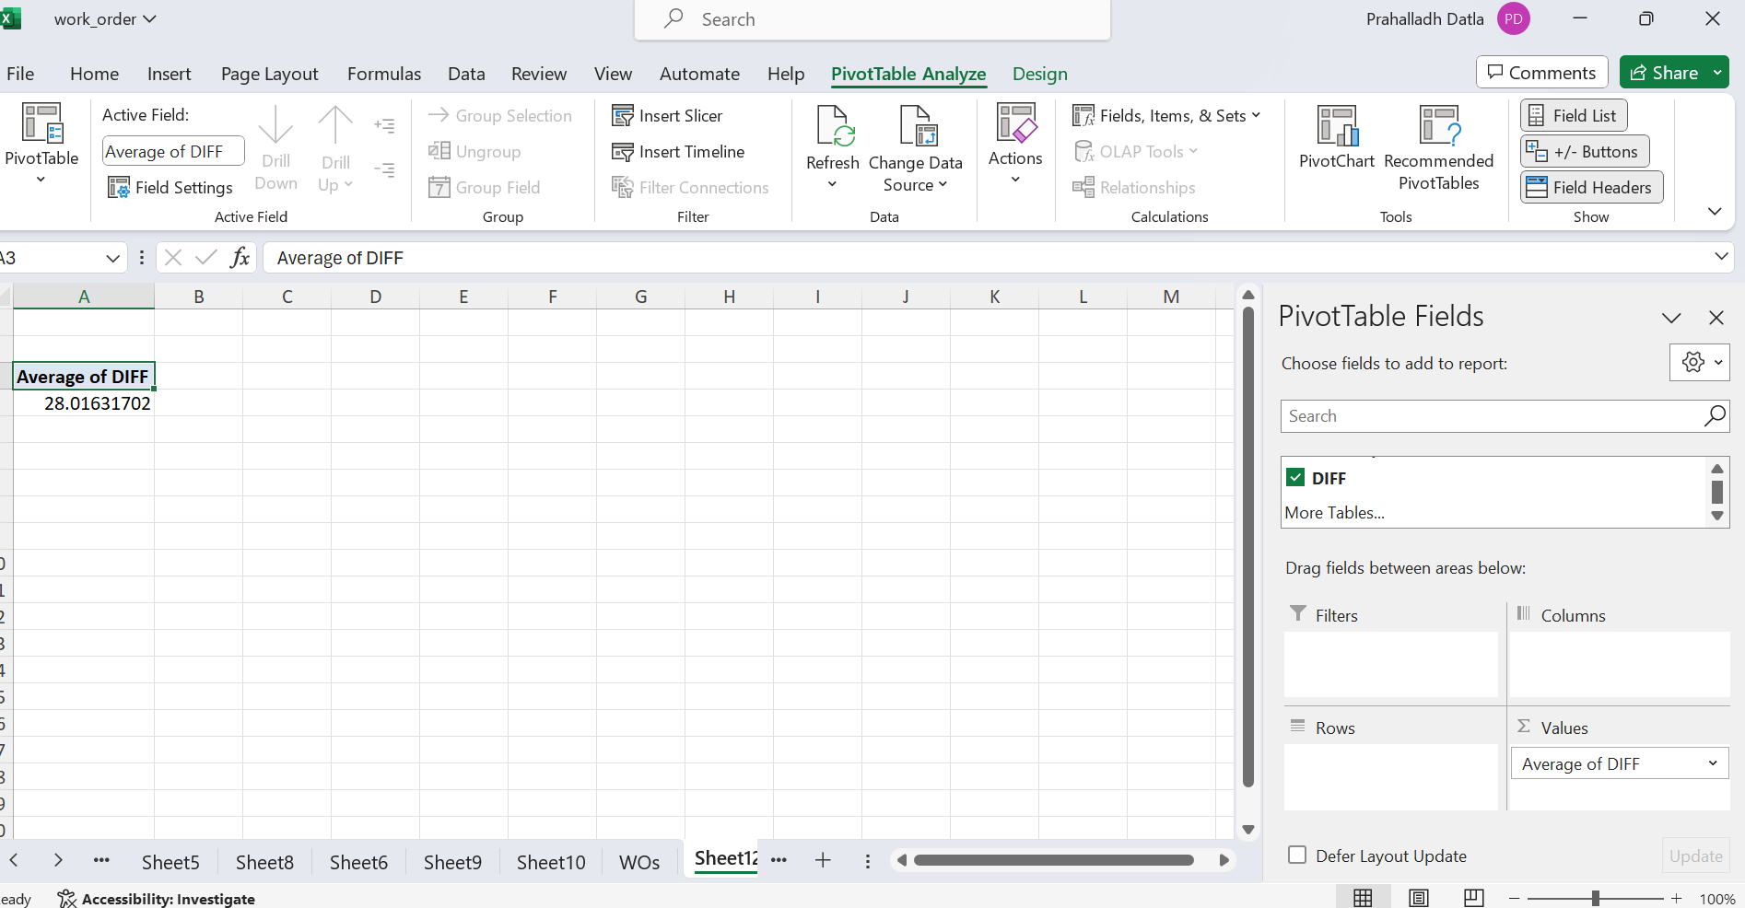
Q1
Using wait column Which gives us the no.of days it to took to solve the work order. And then the average of the column to get the average lead time between them which is 28 days on Average

Slide 2
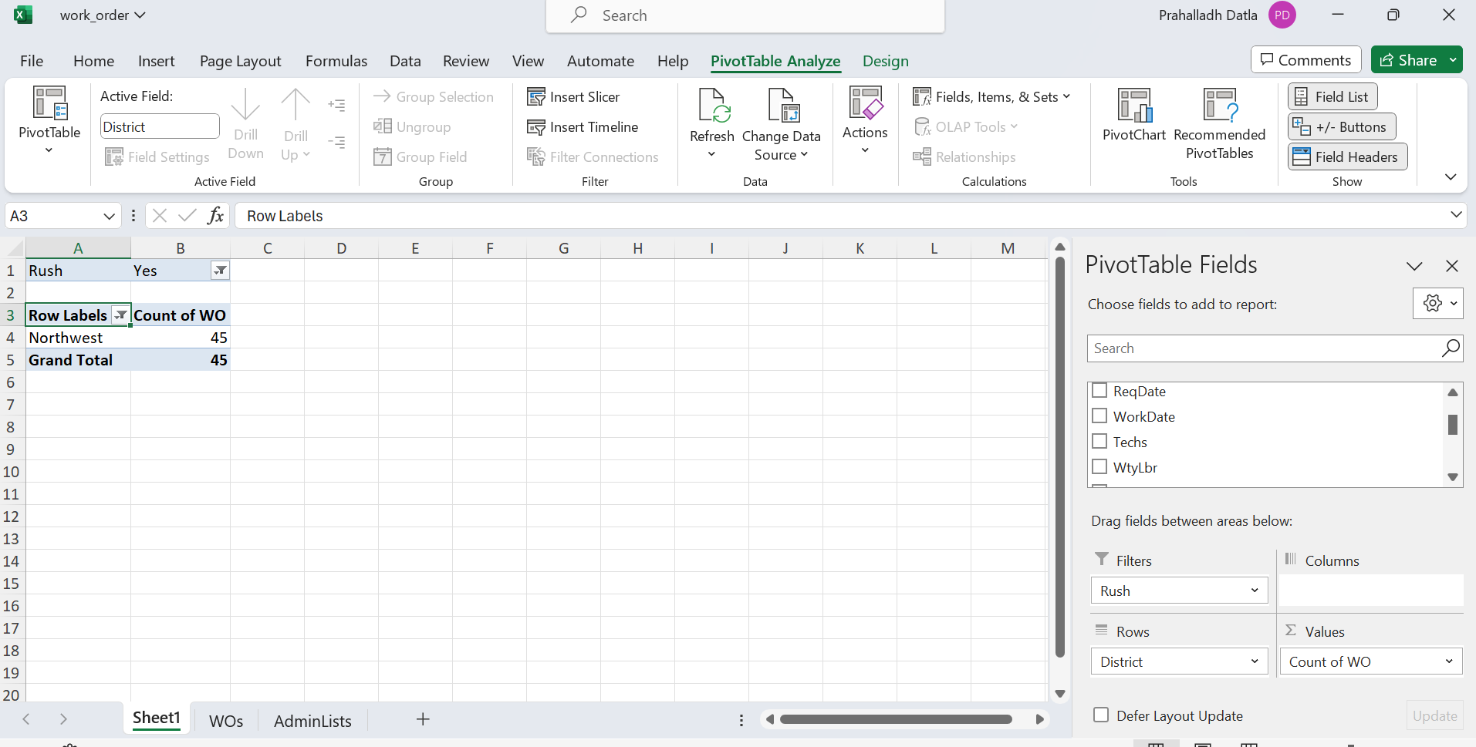
Q2
Used pivot table, Filtered the data with Only Rush Jobs, And then District wise Rush jobs count. Used Top 1 Value filter to get the District with most no of Rush Jobs which is Northwest

Slide 3
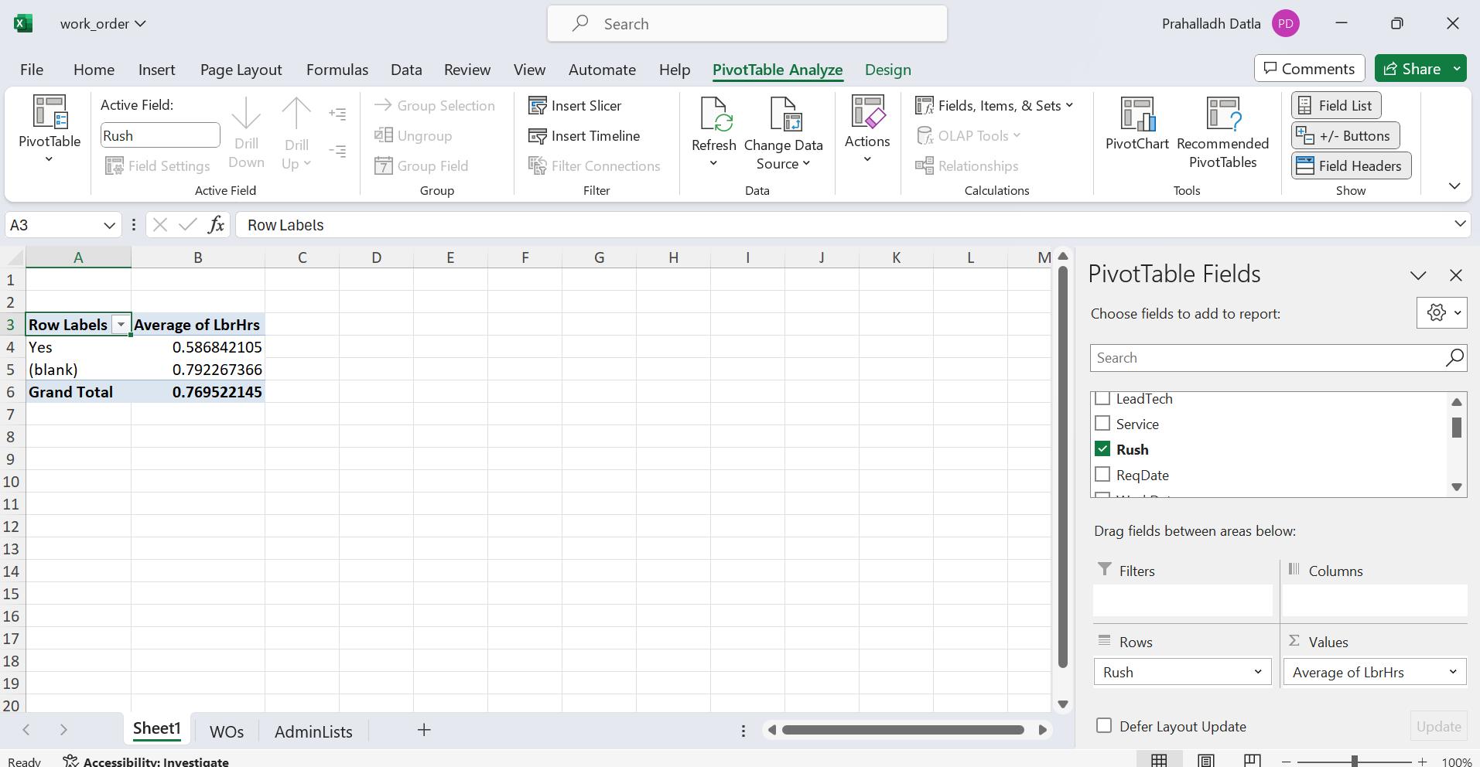
Q3
Used Pivot Table, The Average difference between Rush Job and Non-Rush Job LbHrs is 0.20

Slide 4
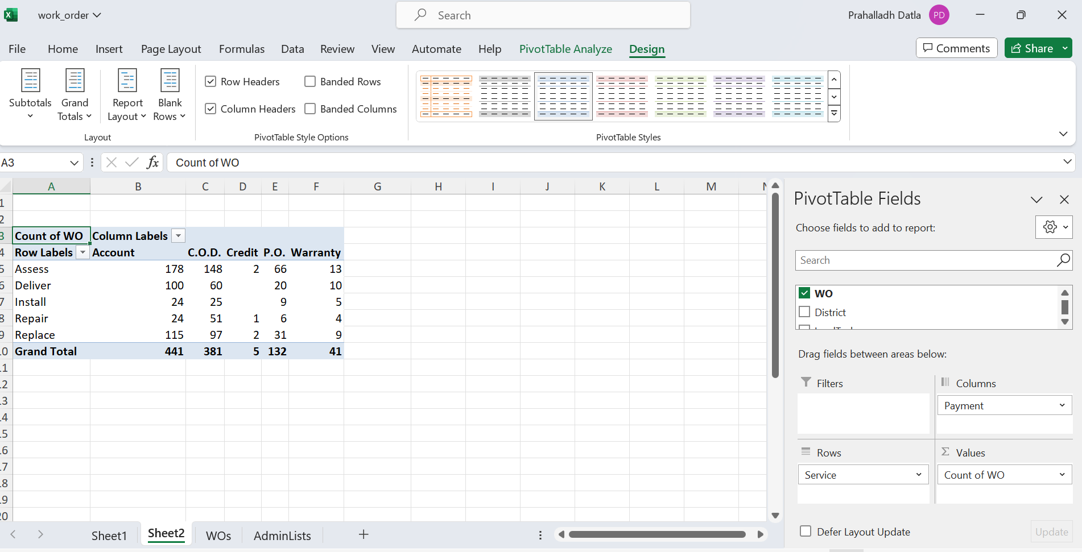
Q4
Cont..

Slide 5
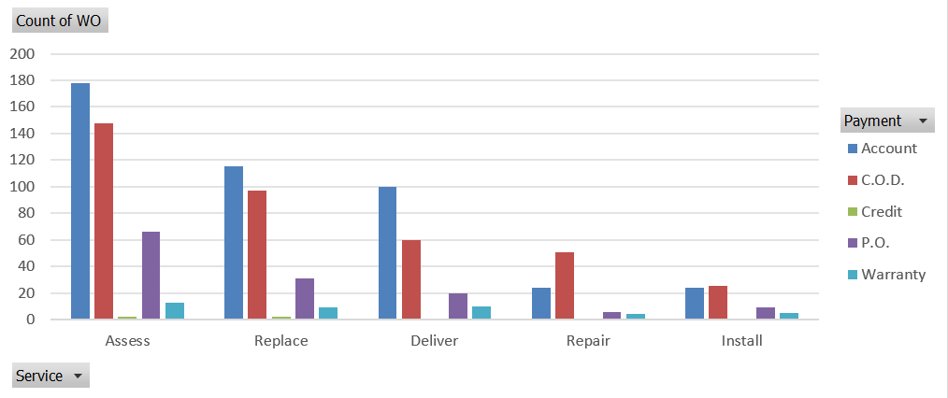
Q4
Used Pivot Table, we can see the distribution of different payment methods wrt to diff services. Account transfer is the most preferred payment method for all the services except Install service,Followed by COD. Credit is the least preferred.

Slide 6
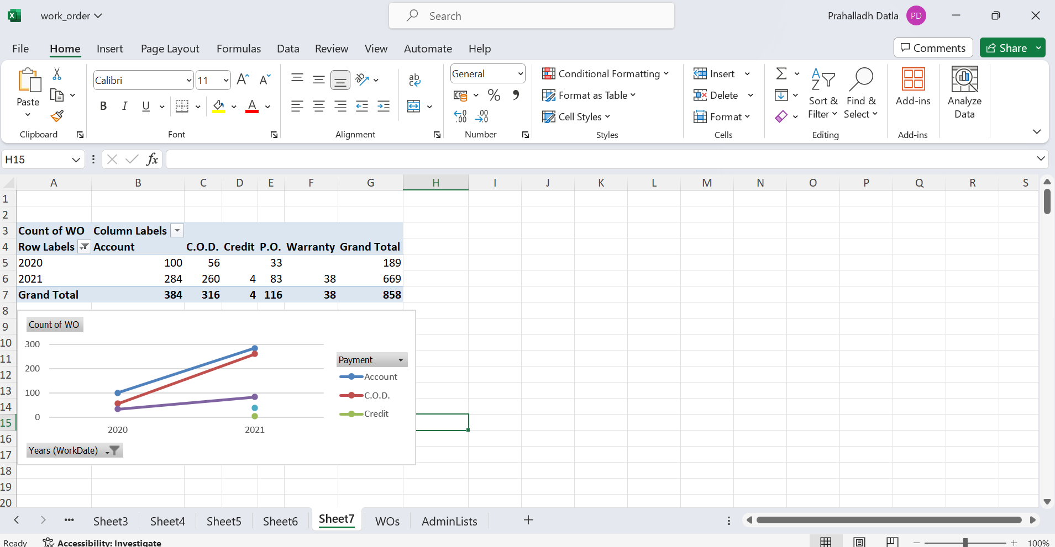
Q5
Used Pivot Table to find out the trend in the payment types.
As we can see from the graph there is a substantial increase in Account, COD and P.O from 2020 to 2021. In 2021 new payment methods such as Warranty, Credit has come up where in 2020 no such payment options were used if available.

Slide 7
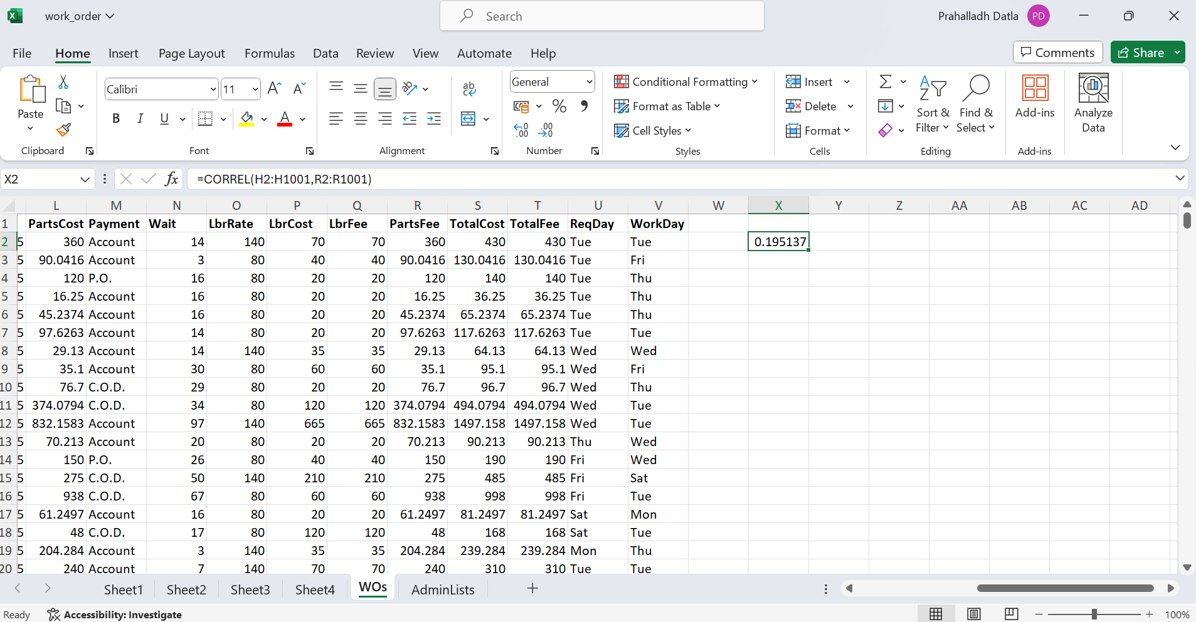
Q6

Slide 8
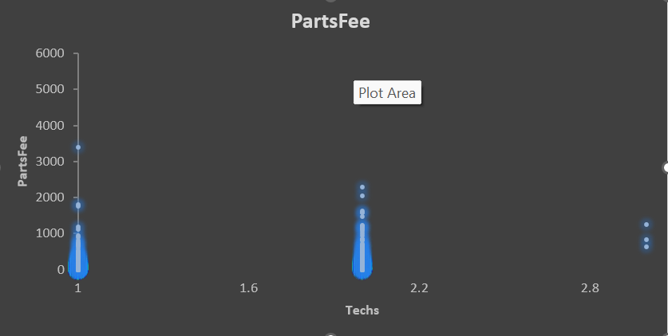
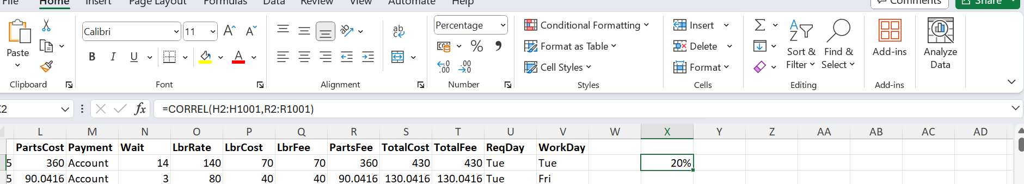
Q6
=CORREL(H2:H1001,R2:R1001)
Used Correlation formula to get the relation between the no.of technicians and parts cost
Which got be + 20% correlation. From the data and as well from the scatterplot we can say that there is a relationship between no.of technician and Parts Cost. Which increases with the increase of no.of technicians.

Slide 9
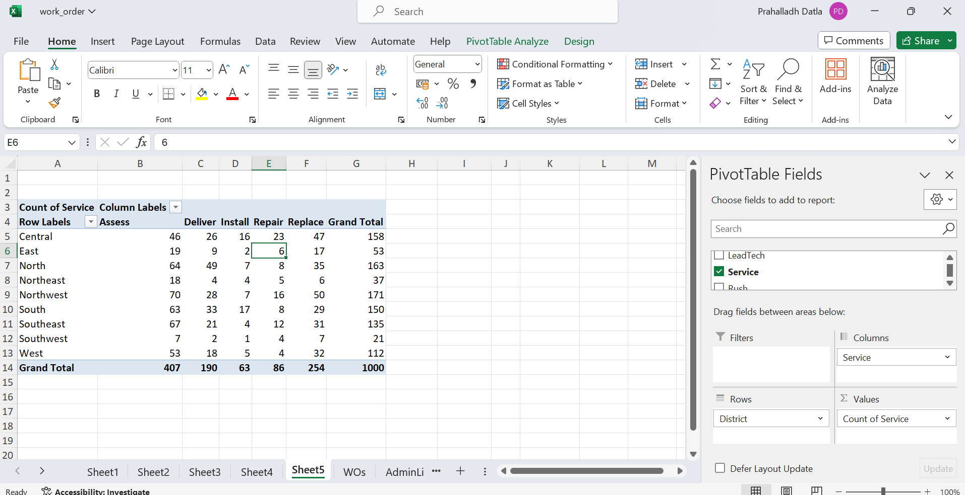
Q7
Used Pivot Table, District wise count of services. And then used filter
In Central district Replaces service(47), And in rest all districts Assess services is
The most common service.

Slide 10
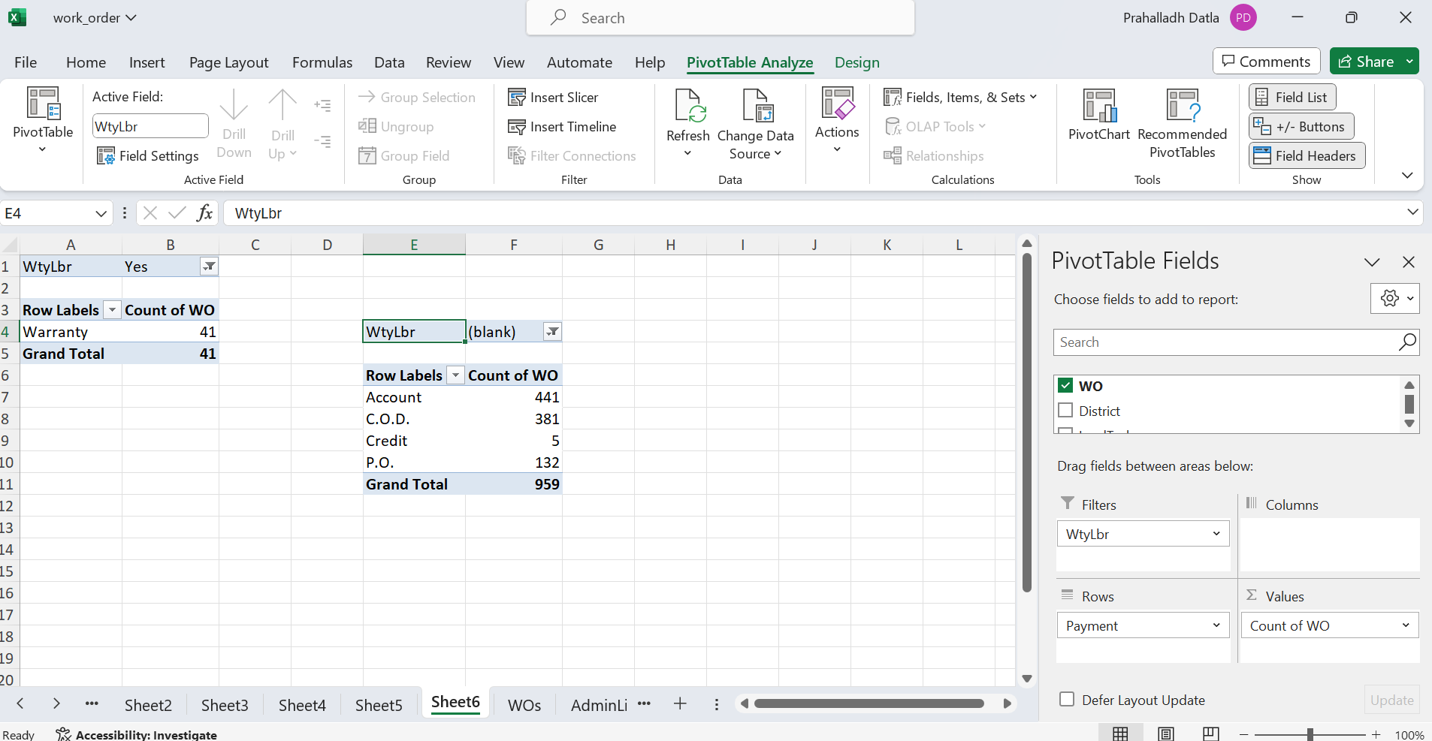
Q8
Used two Pivot Tables to get the difference, In one I have filtered the data based on WtyLbr it shows only the work orders with warranty Labour has an option of Warranty Payment. For all other work orders who doesn’t have WtyLbr there is no warranty payment option which is understood may be depending on the warranty getting expired or such. All those have other payment options such as Account, COD,Credit,P.O

Slide 11
DASHBOARD

Slide 12
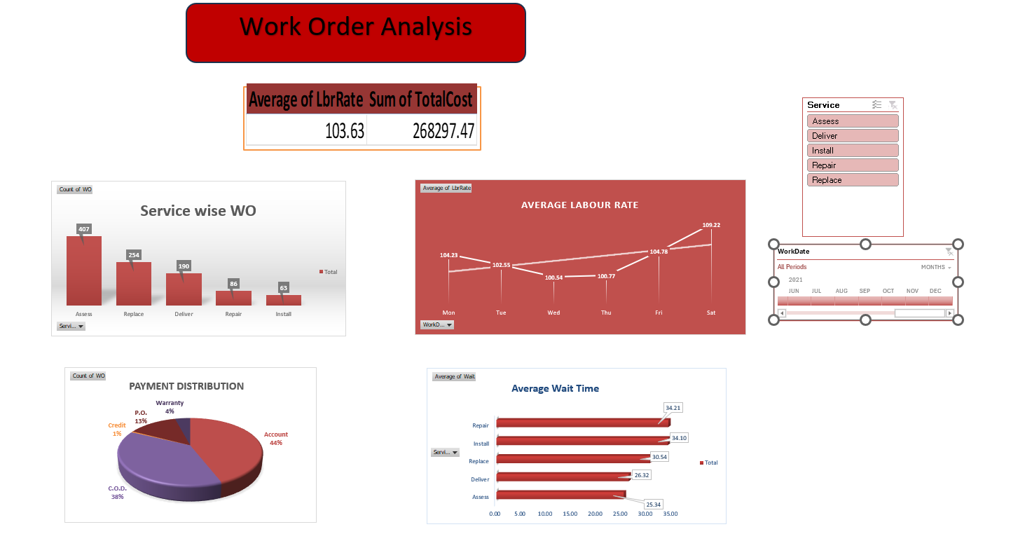

Slide 13
